Slide 1
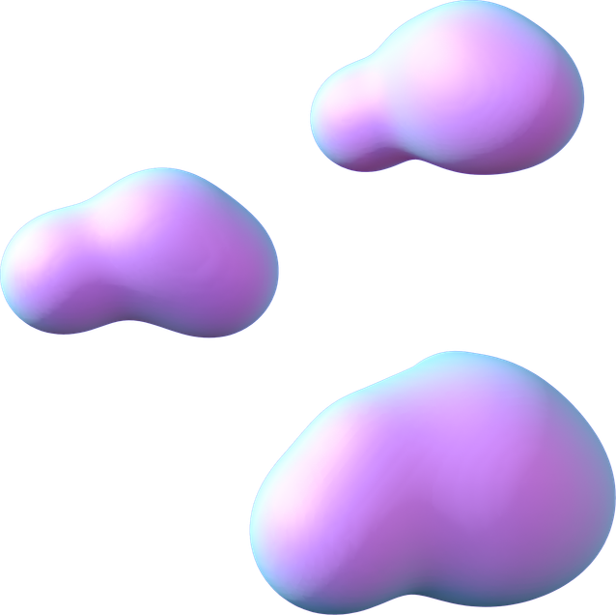



MILESTONE -2
PRESENTATION
Presented by Venkata Sai Pranavi

Slide 2
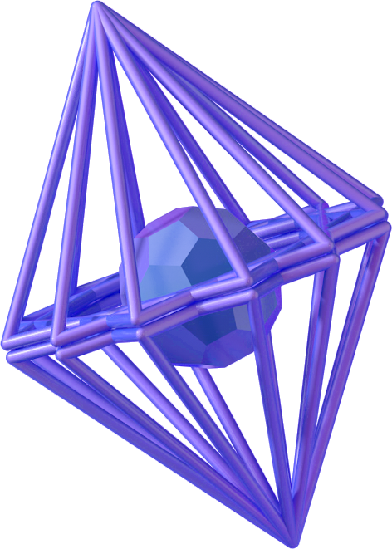
TASK ASSIGNED
As part of the Infosys Springboard Internship, the task assigned for Milestone 2 is:
To conduct detailed research on different types of OCR (Optical Character Recognition) models.
To understand how various OCR techniques work (Traditional, Deep Learning, Transformer-based, Layout-aware).
To compare their advantages and limitations for receipt and invoice digitization.
To implement selected OCR models in Google Colab.
To analyze the extracted output and evaluate performance.
To identify the most suitable OCR model for the “Receipt & Invoice Digitizer” project.

Slide 3
INTRODUCTION TO OCR
What is OCR (Optical Character Recognition)?
Optical Character Recognition (OCR) is a technology that converts text from images into machine-readable text.
It can extract text from scanned documents, photos, PDFs, receipts, and invoices.
OCR allows computers to read printed or handwritten text automatically.
It eliminates the need for manual data entry.
OCR is widely used in banking, healthcare, retail, and document digitization systems.

Slide 4
NEED FOR OCR IN INVOICE DIGITIZATION
Automatically extracts text like:
Invoice Number
Date
Vendor Name
Total Amount
Reduces manual effort and saves time.
Improves accuracy and efficiency.
Enables digital storage and easy search.
Helps in faster accounting and auditing.

Slide 5
LIST OF CONTENTS
1
PyTesseract
Deep Learning OCR
2
Transformer-Based OCR
3
4
Layout-Aware OCR
5
Cloud-Based OCR

Slide 6

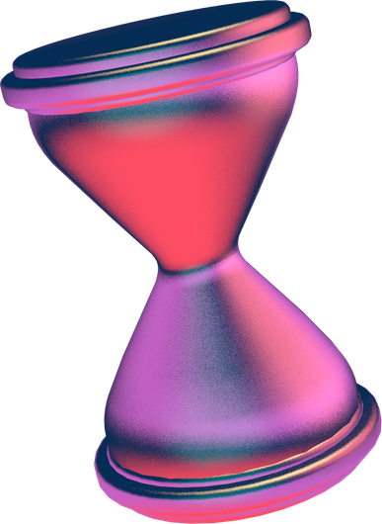
TRADITIONAL OCR – TESSERACT
Tesseract is an open-source OCR engine developed by Google.
It uses image processing techniques and LSTM-based text recognition.
Best suited for clean, printed text documents.
Works well when image quality is high and text is clearly aligned.
✅ Advantages
Free and open-source
Easy to implement
Good accuracy for printed text

Slide 7
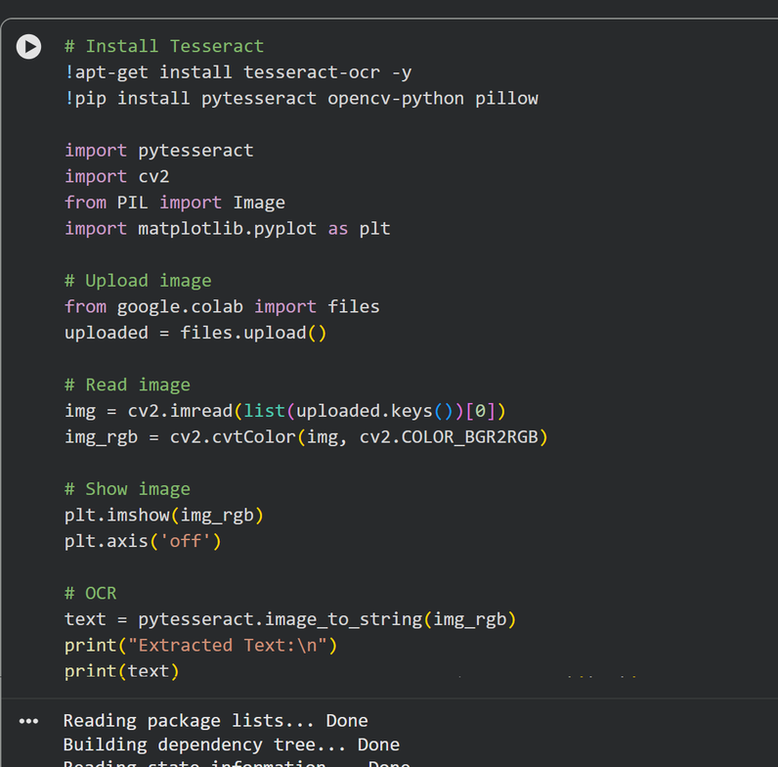
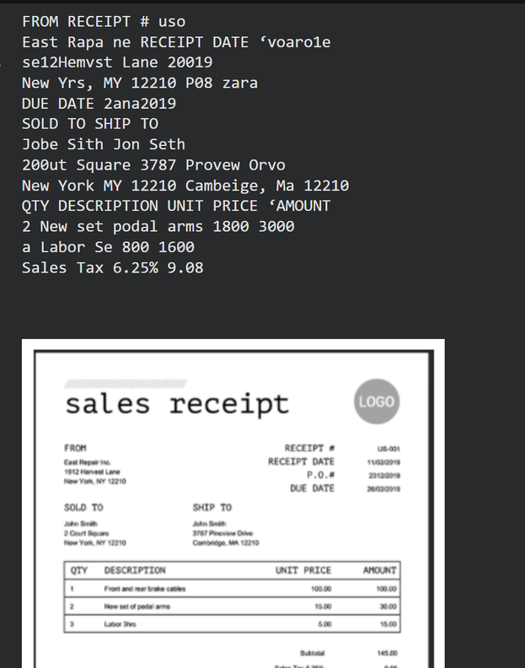
TRADITIONAL OCR – TESSERACT

Slide 8
DEEP LEARNING-BASED OCR – EASYOCR
EasyOCR is a deep learning-based OCR library.
Uses Convolutional Neural Networks (CNN) and Recurrent Neural Networks (RNN).
Supports multiple languages.
Performs better on noisy and complex images.
✅ Advantages
Better accuracy than traditional OCR
Handles different fonts and layouts
Multi-language support

Slide 9
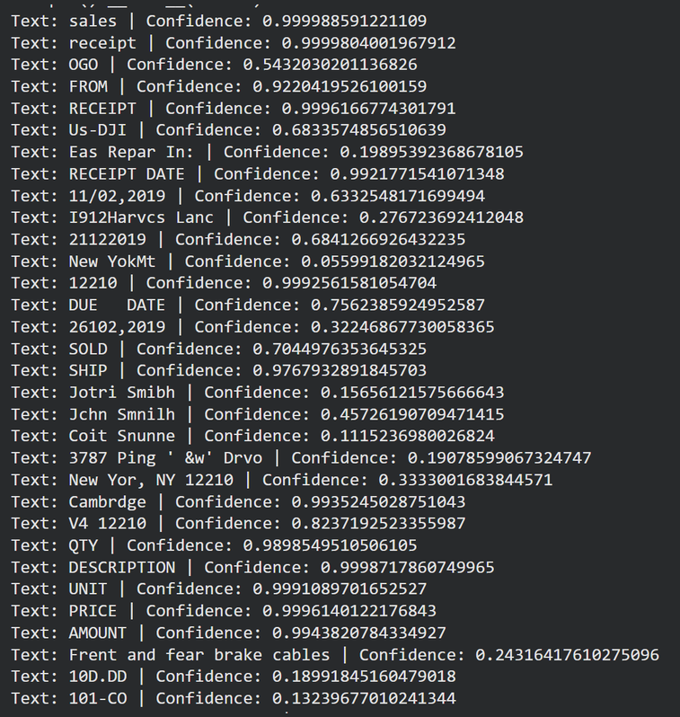
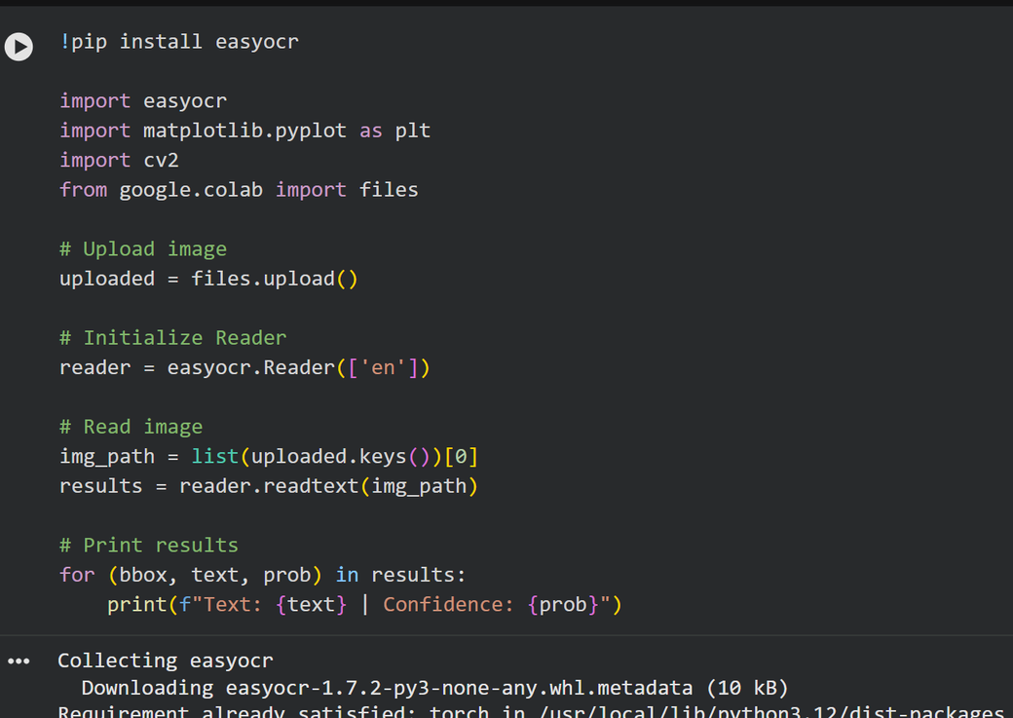
DEEP LEARNING-BASED OCR – EASYOCR

Slide 10
TRANSFORMER-BASED OCR – TROCR
TrOCR is developed by Microsoft.
Uses Vision Transformers for text recognition.
State-of-the-art performance for printed and handwritten text.
Learns contextual relationships between words.
✅ Advantages
High accuracy
Good for handwritten and complex text
Context-aware recognition

Slide 11
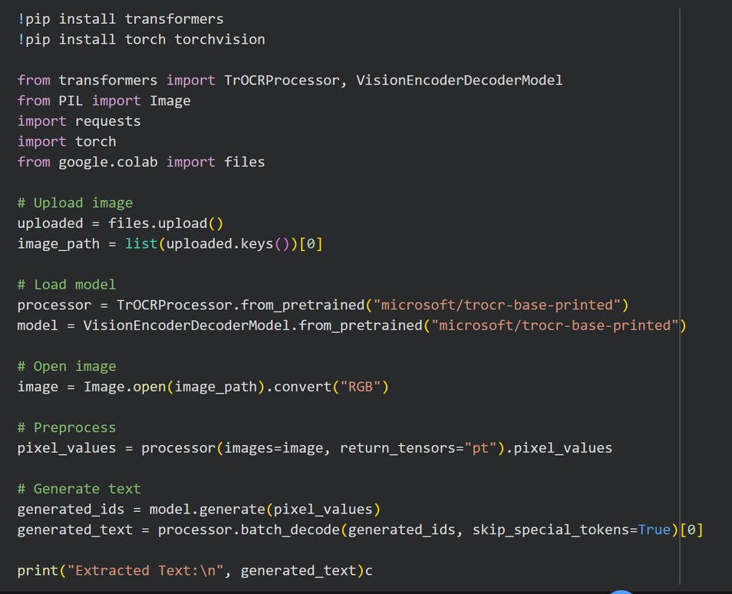
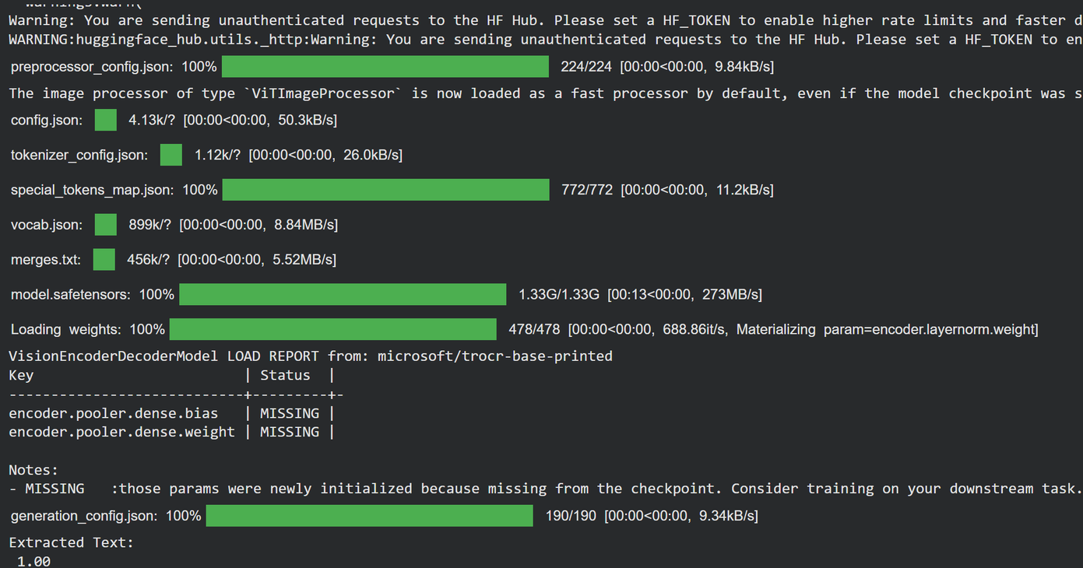
TRANSFORMER-BASED OCR – TROCR

Slide 12
Cloud OCR – Google Vision API
Cloud-based OCR service provided by Google.
Uses advanced deep learning models.
Provides high accuracy and scalability.
✅ Advantages
Very high accuracy
No need to train models
Handles large-scale data
❌ Limitations
Paid service
Requires internet and API setup

Slide 13
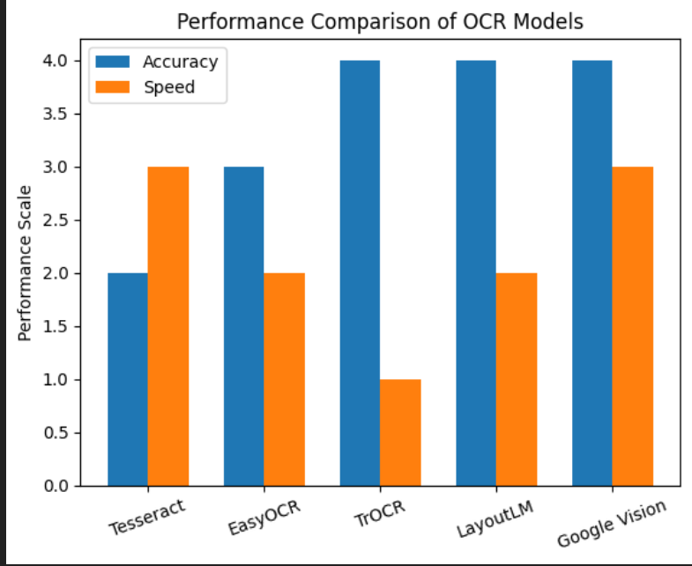
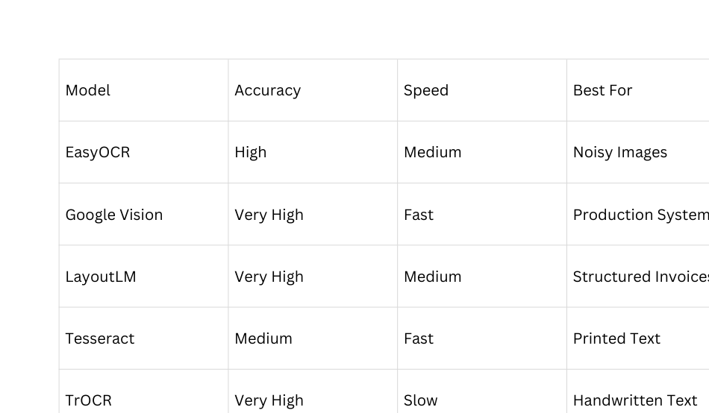
ANALYSIS

Slide 14



FUTURE WORK
Future Enhancements – Key-Value Extraction & Automation
Implement automatic key-value pair extraction.
Train custom model for invoice-specific data.
Integrate OCR with database storage.
Develop a web interface for uploading invoices.
Improve preprocessing techniques for higher accuracy.

Slide 15
THANK YOU
Presented by Venkata Sai Pranavi

